Slide 1
Risk Assessment and Management &
Risk Based Audit Approaches
Kiran Joshi

Slide 2
Table of Contents
Introduction
Risk
Risk Assessment and Calculations
Losses & Controls
Risk Management Model
Things to Consider
Risk Treatments
Types of Treatments
Methodology
How to manage the Risk?
Risk Based Audit Approaches
Keep it touch!

Slide 3

Risk Impact
The Effect a Risk can have
Risk = (probability of event occurring) x (impact of the event occurring)
The probability of something happening that will have an adverse impact upon any of the assets like people, plant, equipment, financials, data etc. and the impact of loss of such an asset both needs to be considered to quantify the risk.
Basis the classification then appropriate actions can be taken as per cost benefit analysis

Slide 4
Risk Assessment – a definition
“The process of identifying the risks to system security and determining
the probability of occurrence, the resulting impact,
and additional safeguards that would mitigate this impact.”

Slide 5




Classification of Losses
The types of losses which can occur
Financial
Operational
Reputational
Legal
loss of money or decrease in financial value.
loss of operational integrity of the process.
loss reputation of the organization due to interruption of services .
Losses means any and all Expenses, damages, losses, liabilities, judgments, fines, penalties.

Slide 6





2.Control risk
3.Detection risk
1.Inherent risk
Types of risk
4.Overall audit risk
(Inherent * Control * Detection)

Slide 7
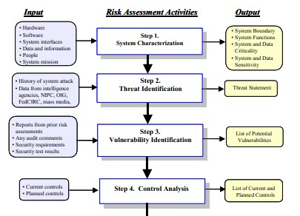
7

Slide 8
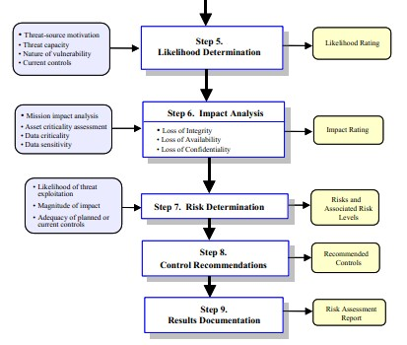
8

Slide 9
Risk Assessment Methodology
○
Step 1: System Characterization
Input: system-related info including
Hardware
Software
System interfaces
Data and information
People
System mission
Output:
A good picture of system boundary, functions, criticality and sensitivity

Slide 10
Risk Assessment Methodology
Step 2: Threat Identification
Input:
Security violation reports
Incident reports
Data from intelligence agencies and mass media
Output:
Threat statement listing potential threat- sources
(natural, human, environmental) applicable to
the system being evaluated

Slide 11
Risk Assessment Methodology
Step 3: Vulnerability Identification
Input:
System security tests (e.g. VA/penetration tests)
Audit results
Vulnerability lists/advisories
Automated Vulnerability scanning tool- Nessus, GFI, Open VAS, etc.
Security Test & Evaluation (ST & E)- Development & Execution of test plan
Security requirements checklist (contains basic security standards)
Output:
List of system vulnerabilities (flaws or weaknesses) that could be exploited – Vulnerability/Threat pairs

Slide 12






Security Analysis Technique
Ways to analyze the controls’ sufficiency
Vulnerability Assessment
Penetration Testing
Application Design Review
Security Assessment & Audit
Source Code Review
Gap Analysis

Slide 13
Vulnerability Sources
Major area to be included
Management
Assigning Responsibilities, support continuity, incident response capability, periodic review, risk assessment, security & technical training etc.
Operational
Controlling env. like smoke, dust etc., power supply, media access & disposal, external data distribution, facility protection, humidity, temperature control etc.
Technical
Communications, cryptography, discretionary access control, identification & authentication, intrusion detection, object reuse, system audit

Slide 14
Risk Assessment Methodology
Step 4: Control Analysis
Input: current controls, planned controls
Control Methods – may be technical or non- technical
Control Categories – preventative or detective (e.g. audit trails)
Output:
List of current and planned controls

Slide 15
Types of Controls
What each level means in terms of security
Administrative
Policies & procedures; including personal controls such as security clearances, background checks etc.
Technical (Logical)
Anti virus programs, password protection, firewall, ACLs, auditing etc.
Physical
Locks, alarms etc.

Slide 16
Risk Assessment Methodology
Step 5: Likelihood Determination
Input:
Threat-source motivation & capability
Nature of the vulnerability
Existence & effectiveness of current controls
Output:
Likelihood rating of High, Medium or Low

Slide 17
Likelihood Level
The Probability of Event Occurring
High
The Threat-source is highly motivated and sufficiently capable, and controls to prevent the vulnerability from being exercised are ineffective
Medium
The threat source is motivated and capable, but controls are in place that may impede successful exercise of the vulnerability
Low
The threat-source lacks motivation or capability or controls are in place to prevent, or at least significantly impede, the vulnerability from being exercised

Slide 18
Risk Assessment Methodology
Step 6: Impact Analysis
Input:
System mission
System and data criticality
System and data sensitivity
Analysis:
Adverse impact described in terms of loss or degradation of integrity, confidentiality, availability
Output:
Impact Rating of High, Medium or Low

Slide 19
Magnitude of Impact Analysis
Measuring the Impact
High
Exercise of the vulnerability may result in (1) expensive loss of major tangible assets or resources (2) significant damage to organization (3) human death/ injury
Medium
Exercise of the vulnerability may result in (1) expensive loss of some tangible assets or resources (2) some damage to organization (3) human injury
Low
Exercise of the vulnerability may result in (1) some loss of some tangible assets or resources (2) may affect organization’s mission, reputation or interest

Slide 20


Types of Impact Analysis
Qualitative & Quantitative
Qualitative
Quantitative
It provides a measurement of the impacts’ magnitude
Depending on the numerical ranges used to express the measurement, the meaning of the quantitative impact analysis may be unclear
Prioritizes the risks and identifies areas for immediate improvement in addressing the vulnerabilities
Making a cost-benefit analysis of any recommended controls difficult, because it does not provide specific quantifiable measurements of the magnitude of the impacts

Slide 21
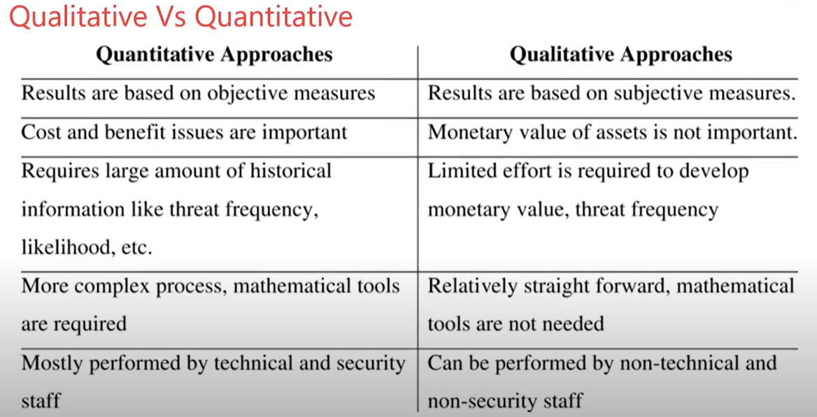

Slide 22
Risk Assessment Methodology
Step 7: Risk Determination
Input:
Likelihood of threat
Magnitude of risk
Adequacy of planned or current controls
Output:
Risk Level Matrix (Risk Level = Threat Likelihood x Threat Impact)
Risk Scale and Necessary Actions

Slide 23
Description of Risk Level
What each level means in terms of security
High
There is a strong need for corrective measures. An existing system may continue to operate, but a corrective action plan must be put into place asap.
Medium
Corrective actions are needed and a plan must be developed to incorporate these actions within a reasonable period of time.
Low
System’s DAA must determine whether corrective actions are still required or decide to accept the risk

Slide 24
Risk-Level Matrix
Threat Likelihood | Impact
 | Low (10) | Medium (50) | High (100)
High | Low | Medium | High
(1.0) | 10 X 1.0 = 10 | 50 X 1.0 = 50 | 100 X 1.0 = 100
Medium | Low | Medium | Medium
(0.5) | 10 X 0.5 = 5 | 50 X 0.5 = 25 | 100 X 0.5 = 50
Low | Low | Low | Low
(0.1) | 10 X 0.1 = 1 | 50 X 0.1 = 5 | 100 X 0.1 = 10

Slide 25
Risk Assessment Methodology
Step 8: Control Recommendations
Factors to consider
Effectiveness of recommended option
Legislation and regulation
Organizational policy
Operational impact
Safety and reliability
Output:
Recommended controls and alternative solutions to mitigate risk

Slide 26
Control Recommendation
Types of controls which can be recommended
Deterrent Controls
Discourage incidents
Preventive Controls
Detective Controls
Avoid incidents
Identify Incidents
Corrective Controls
Remedy/ mitigate the incidents
Compensative Controls
Alternative controls (e.g. supervision)
Recovery Controls
Restore Conditions to NORMAL

Slide 27
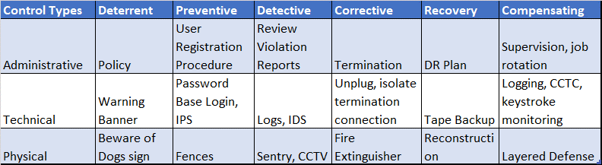
Control Matrix
Matching Type of controls with recommendations
The above table illustrates various methods which can be adopted for each of the recommendation type and control type.

Slide 28
Risk Assessment Methodology
Step 9: Results Documentation
Output:
Risk Assessment Report
Presented to senior management and mission owners
Describes threats & vulnerabilities, measures risk and provides recommendations on controls to implement
Purpose: Assist decision-makers in making decisions on policy, procedural, budget and system operational and management changes

Slide 29
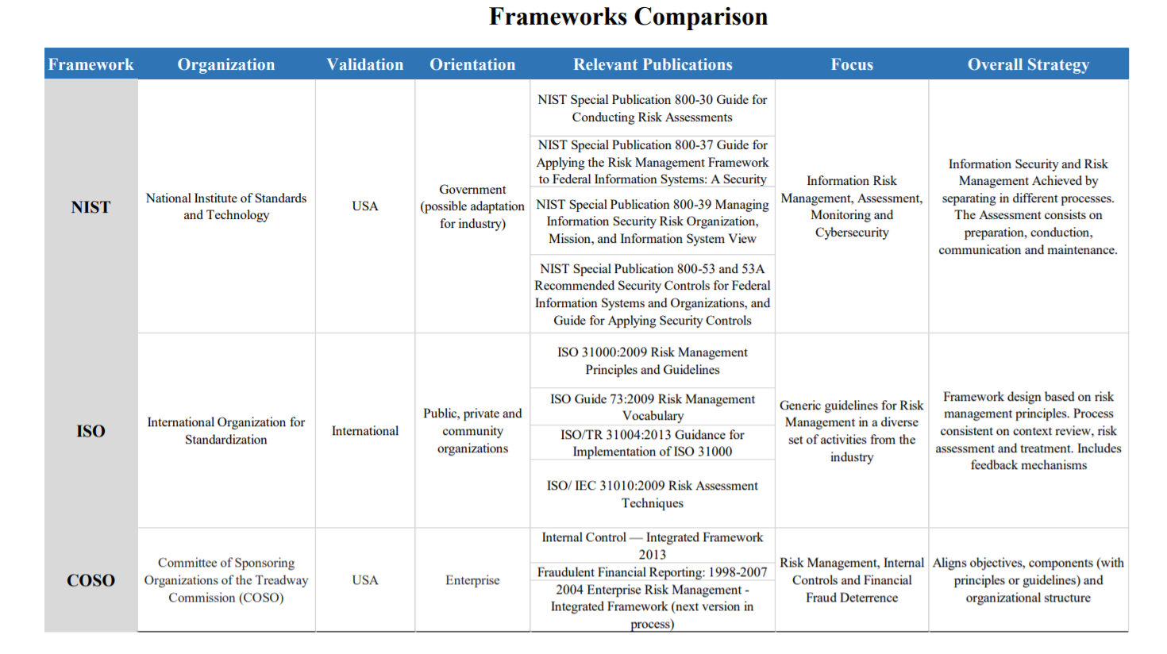

Slide 30


Types of Risk Treatments
MATR & 4T
4 T
MATR
Mitigate
Transfer
Accept
Reject
Treat
Transfer
Tolerate
Terminate

Slide 31
Risk Mitigation
Mitigating the risks identified
Risk Assumption
Accepting potential risk & continue operating the IT system or lower risk to acceptable level
Risk Avoidance
Risk Limitation
Shout down/ forego some systems/ functions when the risks are identified.
Controls which limit the risk by using supporting, preventive detective controls
Research & Acknowledgement
To lower the risk of loss by acknowledging the vulnerability or flaw & researching controls to correct the vulnerability
Risk Planning
Manage the risk by developing plans which prioritize, implement and manage controls
Risk Transference
Transfer the risk by using options such as insurance

Slide 32
Residual Risk
The Risk which we choose to accept
New/ Enhanced Controls
Reduce Number of Flaws/ Errors
Add a targeted control
Reduce Magnitude of Impact
Residual Risk

Slide 33
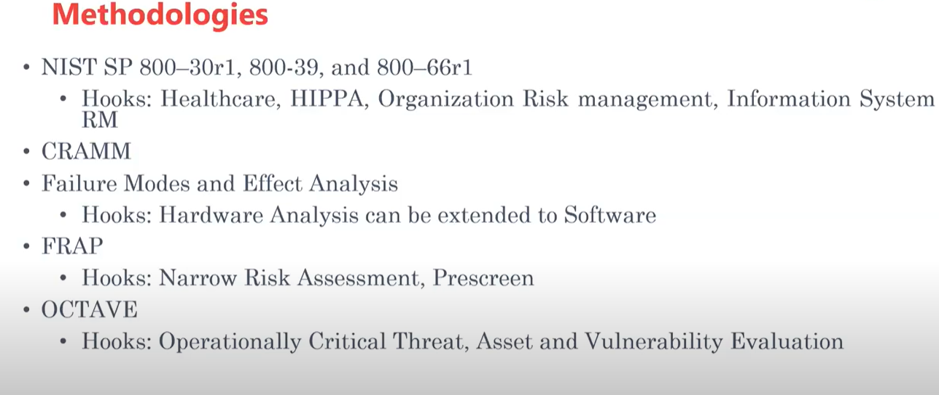

Slide 34
Risk Management Model
Anticipating Threats
Risk Assessment
Identify
Control
Access
Plan
Implement
Monitor

Slide 35
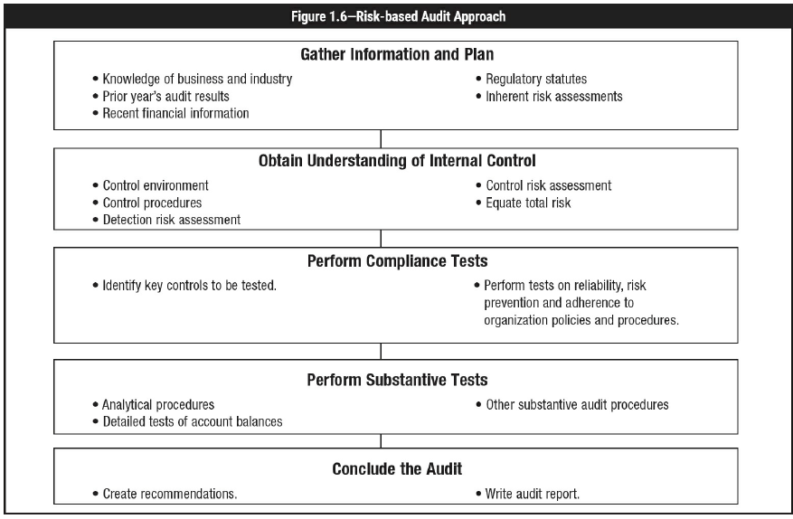

1
INTRODUCTION

